Slide 1

Project Presentation For
Topic Approval
“HealthCare Medical Chatbot”
Submitted to Computer Science Engineering Department
Made By : - Yash Rajput
Department :- Btech
Branch :- Computer Science
Year :- 3rd
Rakshpal Bahadur College of Engineering and Technology, Bareilly
Dr APJ Abdul Kalam Technical University,U.P,Lucknow,
September 2020.

Slide 2
Contents
What is Intelligence, AI and ML
Motivation
Problem statement
Introduction of Health Care and Science
Application of AI in Health Care
Architecture of health care chatbot
Future Work
Conclusion
HealthCare Chatbot Software Information

Slide 3


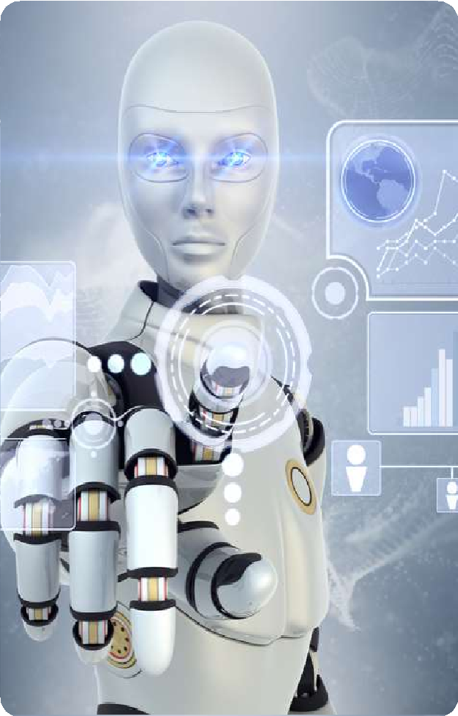
WHAT IS INTELLIGENCE
There is no agreed definition or model of intelligence . Intelligence is a ability to understand and thing about things, and to gain and use knowledge.
“action is the real measure of intelligence.”
“Intelligence is what you do when you don't know what to do.”
“Intelligence is a hypothetical idea which we have defined as being reflected by certain types of behavior.”
Einstein said, “ the true sign of intelligence imagination .”
Can we increase our intelligence ?
Deep thinking
Good reasoning
Learning from past experience
Practise
is not knowledge but

Slide 4


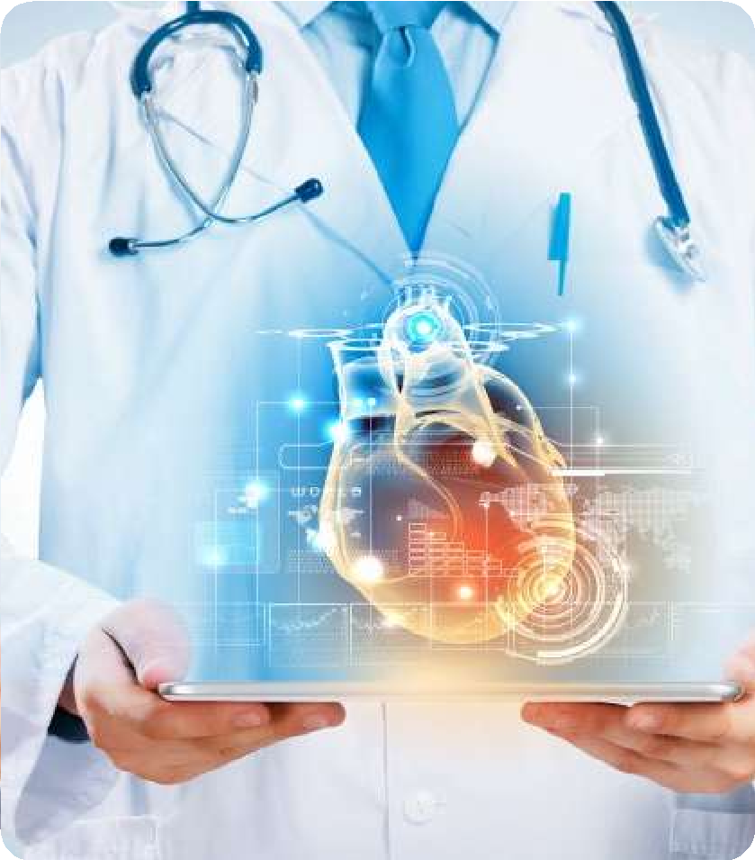
WHAT IS MACHINE LEARNING
machine learning is a branch of computer science which is used to become intelligent a machine . the concept of machine learning says that the machine gains some knowledge with its past experience as humans do . A machine is work , thing , understand and take self
– decision like humans .
WHAT IS ARTIFICIAL INTELLIGENCE
artificial intelligence is a branch of computer science which is used to developed and design intelligent machine which work and thing like human beings , it is used to solve real world problems .
artificial intelligence used perception, reasoning , learning , understanding , thinking and self- decision to expose intelligent behavior.

Slide 5
MOTIVATION
As in this pandemic Social Distancing is very important so to maintain that this project will help everyone.
To find clusters of patients.
To optimize the allocation of human and material resources to wards and shifts.

Slide 6
Problem Statement
Public Health and Surveillance
Lack of immediate retrievals - The information is very difficult to retrieve and to find particular information like- E.g. – To find out about the patient’s history, the user has to go through various registers. This results in in convenience and wastage of time.
Lack of immediate information storage: –The information generated by various transactions takes time and efforts to be stored at right place.

Slide 7
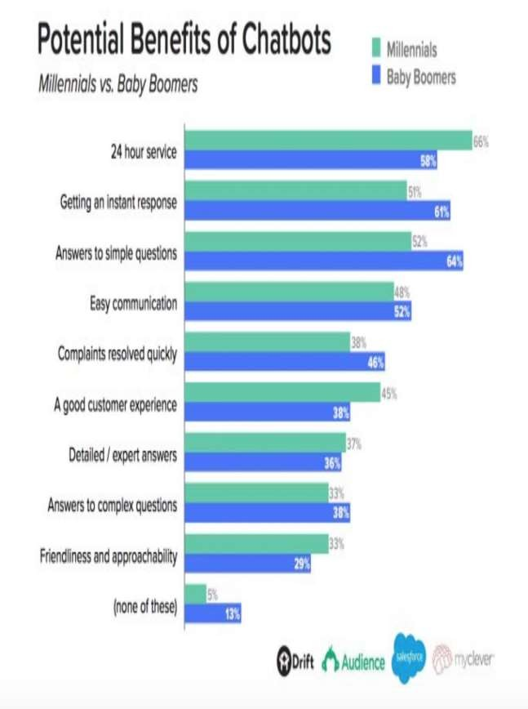
INTRODUCTION
A chatbot is a service or tool that you can communicate with via text messages. Think of chatbots
as human-to-robot
instant artificial
messaging. intelligence computer recognise
Using
and carefully-written
scripts, natural
chatbots can language to conversations
have rudimentary
with your customers.

Slide 8


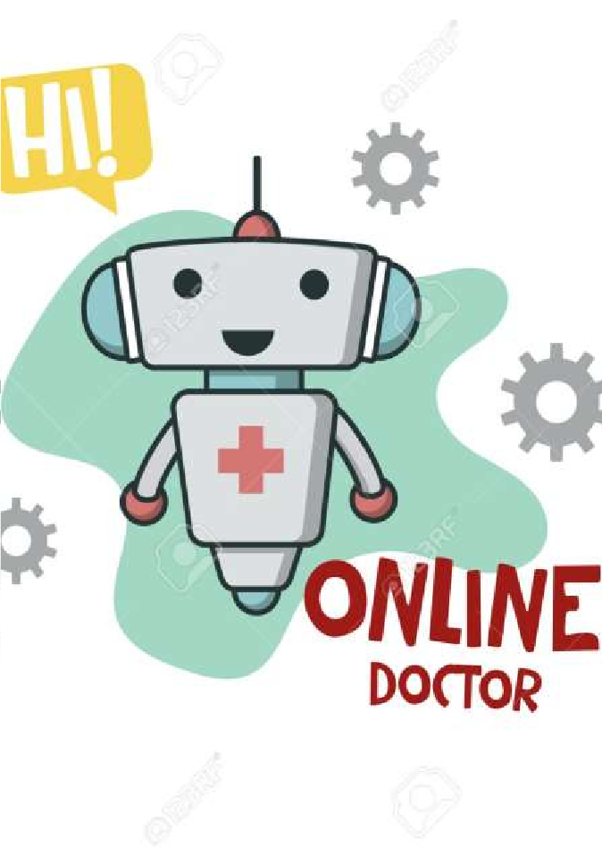
HEALTHCARE AND MEDICAL SCIENCE
In the healthcare field are providing patient assistance and care .
AI-powered medical assistant can book appointment
, monitor a patient health status and perform other time-intensive responsibilities such as inventory , billing and claims management .
There are three key limitations :-
Explainability
Data requirement
Transferability

Slide 9

CURRENT AI USE CASES IN HEALTHCARE
AI in “ data mining “ with ai can predict disease
AI in “ medical imaging and diagnostics “ provide precise information
AI in “ nutrition “ is enhancing the journey to a healthy and fit lifestyle
AI in “ emerging room and surgery “ is saving lives
AI in “ life style management and monitoring “ is changing the way we live .
AI in “ hospital information system ( HIS ) “ can enrich the delivery of healthcare system .
AI in “ research “ is providing fascinating insight .
AI in “ mental health “ is building a strong support system for patients
AI in “ pharma “ is enabling the discovery of a new class of diagnostic and treatment
AI in “ virtual assistant “ to communicate with patients in an efficient way

Slide 10
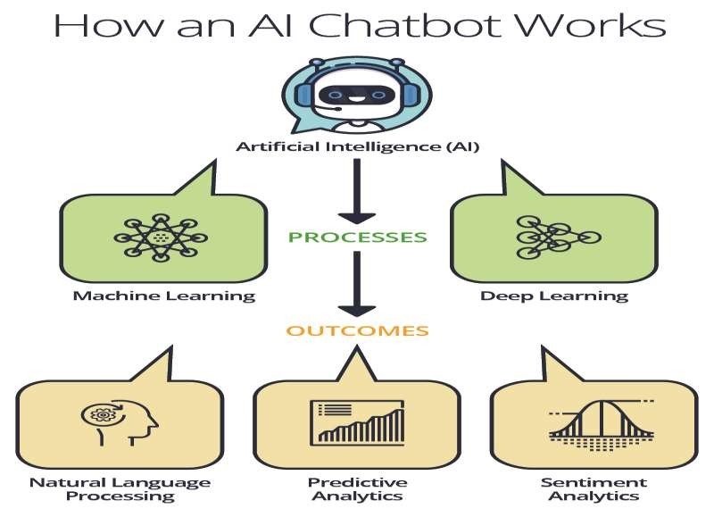
HOW does the system WORKS
With advanced machine learning algorithms and natural language processing enabled, these chatbots can create maps linking symptoms and diseases.
In the industry for medical care, ask some standard questions and help create a profile based on age, sex, and medical history. They can record the user's history and analyze symptoms based on user's inputs.
They can also use image and voice processing to record and match symptoms against the database.

Slide 11
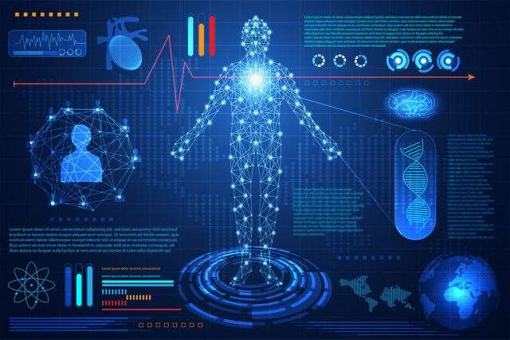
FEATURES OF SYSTEM
Intuitive chatbot creation
Bussiness workflow integration
Natural language understanding
Secure communication support
HIPAA compliance
Deployment on facebook messenger , SMS and web
Chatbot campaigns
Support for image and file
Support video chat
Scalable and expandable

Slide 12
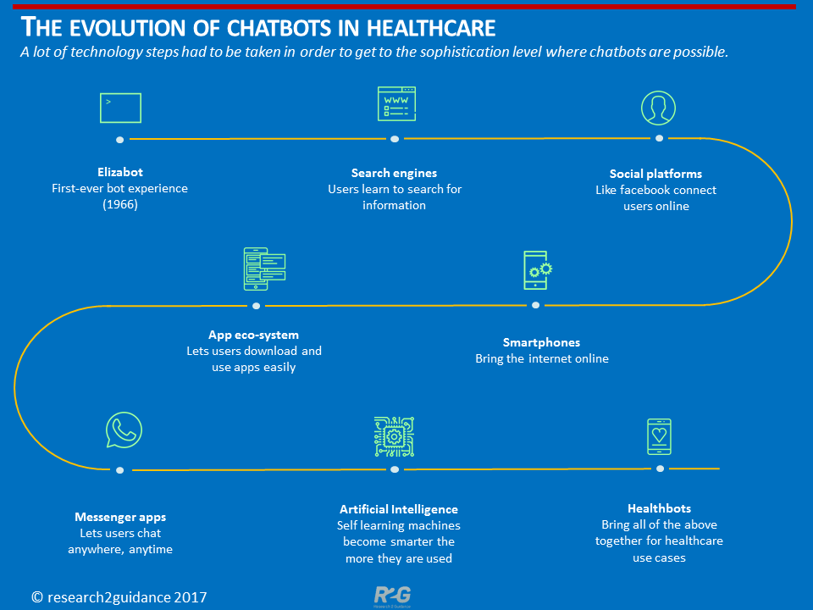
EVOLUTION OF AI IN HEALTHCARE
The evolution of AIS and its application has a vast spectrum in healthcare. The most important reason is that there is non-availability of trained manpower in both medical and para-medical fields.
Healthcare is one of the largest and most rapidly growing segments of AI, driven predominantly by innovation in
clinical research, robotic
data
personal analytics.
to accelerate
assistants and big Healthcare is poised
investments in AI over the next three years

Slide 13
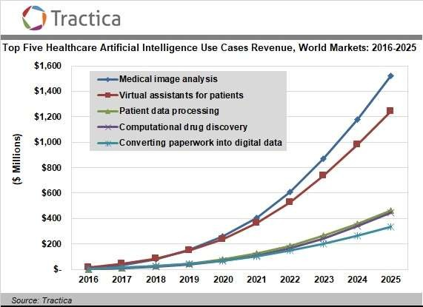
AI IN GLOBAL HEALTHCARE MARKET
In Canada, the city of Hamilton’s health department has collaborated with IBM to built AI capabilities that can improve health outcomes and decrease the cost of care , by leveraging existing patient data .
Chief Information Officer ( CIO ) in healthcare organization are ready to engage AI platforms to achieve greater customer experience , particularly as a recent survey by HCF revealed that over 80% of australians are comfortable with AI being used to diagnose common medical problems are interpret test results .

Slide 14
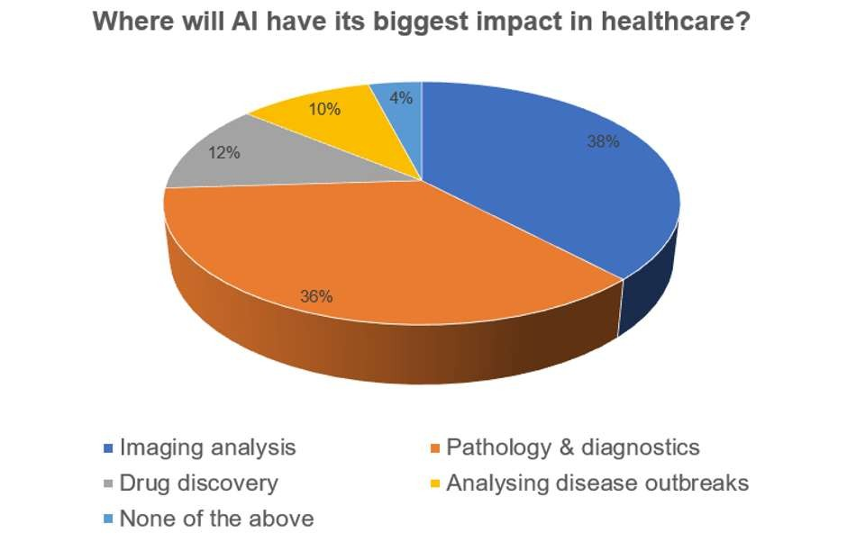
IMPACT OF AI IN HEALTHCARE
According to a 2016 report from CB
Insights , about 86% provider organizations
of healthcare are currently
using AI in some way.
As per world health organization (WHO
), the world will be short of about 13
million healthcare workers by 2035.
Developers have launched more than 33,000 facebook messenger chatbots since April 2016 . What’s more, 80% of frands across industries will be using chatbots for customers interactions by 2020, according to research conducted by oracle .

Slide 15
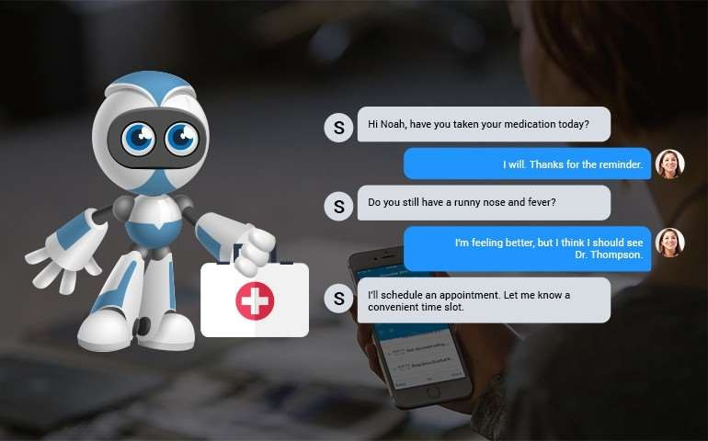
KEY AI TECHNOLOGIES TRANSFORMING HEALTHCARE
Natural language processing
Deep learning
Context aware processing
Intelligent robotics

Slide 16
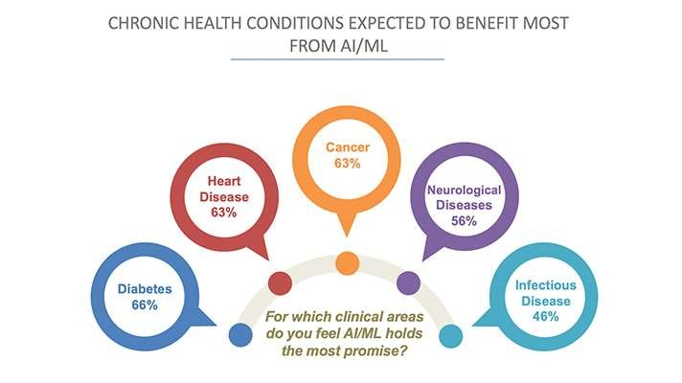
TECHNIQUES OF A.I IN HEALTHCARE SYSTEM
There have been a number of artificial intelligence (AI) tools developed over the past decade Many of these have found their applications in medical and health-related areas. Commonly applied AI techniques can be listed as:
Neural networks
Fuzzy logic
Support vector machines
Genetic algorithms
Hybrid systems
fuzzy logic and the relatively new support vector machines.

Slide 17
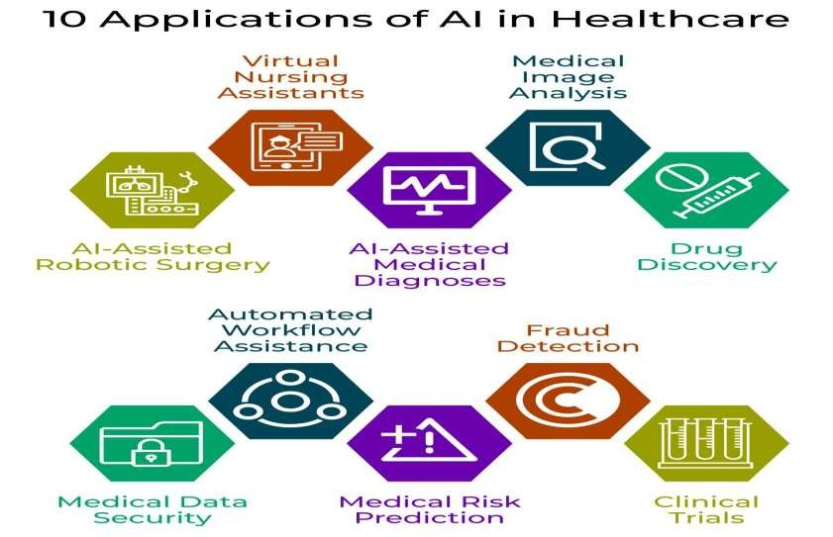
APPLICATIONS OF AI IN HEALTHCARE
Managing medical records and others data
Treatment design
Digital consultation
Virtual nurses
Medication management
Drug creation
Precision medicine
Health monitoring
Healthcare system analysis

Slide 18
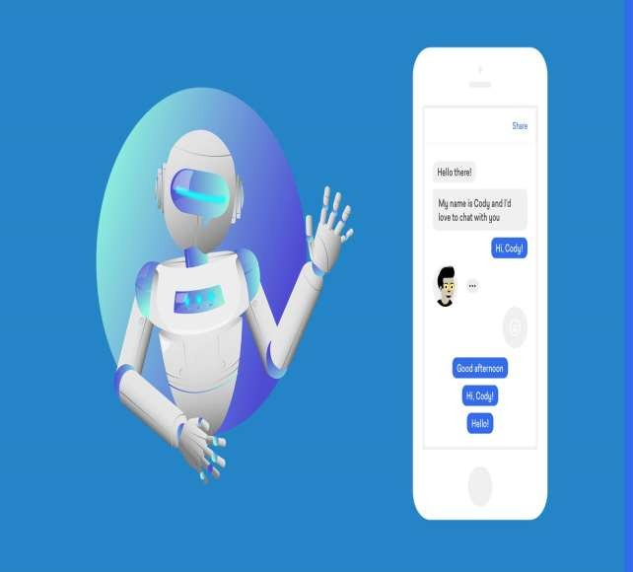
OBSTACLE FOR THIS SYSTEM IN THE FUTURE
One of the main hurdles for AI would be its adoption . Healthcare professionals would have to educated about the need for AI . They should also be made comfortable for work in an environment where AI is present . Many doctors would not be open to the information provided by a machine, and they would be educated to accept AI .
Compliance and FDA regulations can be another major problem . Currently, with AI being only partially understood, the amount of importance that has to be given AI would also be a question that lurks in the minds of the FDA personnel
.

Slide 19
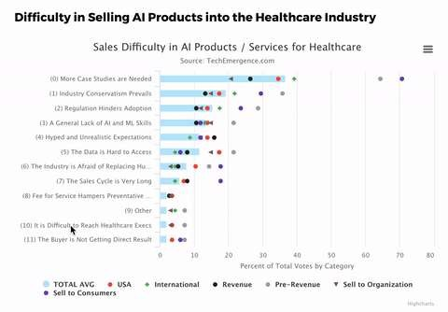
DIFFICULTIES IN HEALTHCARE AI ADOPTION
The industry is receptive to new ways to improve diagnostics, patient
care, and financial efficiencies.
healthcare
However, these AI companies contend with
some
significant challenges with regards to widespread AI adoption in the healthcare.
Case study conundrum
Black box issue
Stakeholder complexities
Current trends

Slide 20
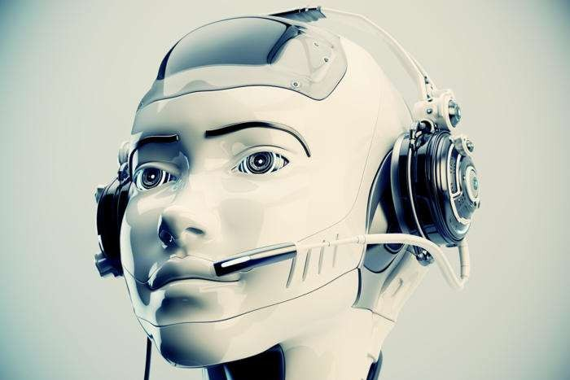
COMPONENTS FOR THE SYSTEM
LOGIC
Logic is the part of the chatbot that decide how to act on the user input
. Standard IF – THEN logic can be enhanced with heuristics & AI creating powerful decision engines .
CONTENT
Content refers to the text & context of the chatbot conversation . Richer
content with subject matter
useful
information leads to more chatbots .

Slide 21
PROCESS FLOW DIAGRAM OF CHATBOT

Slide 22

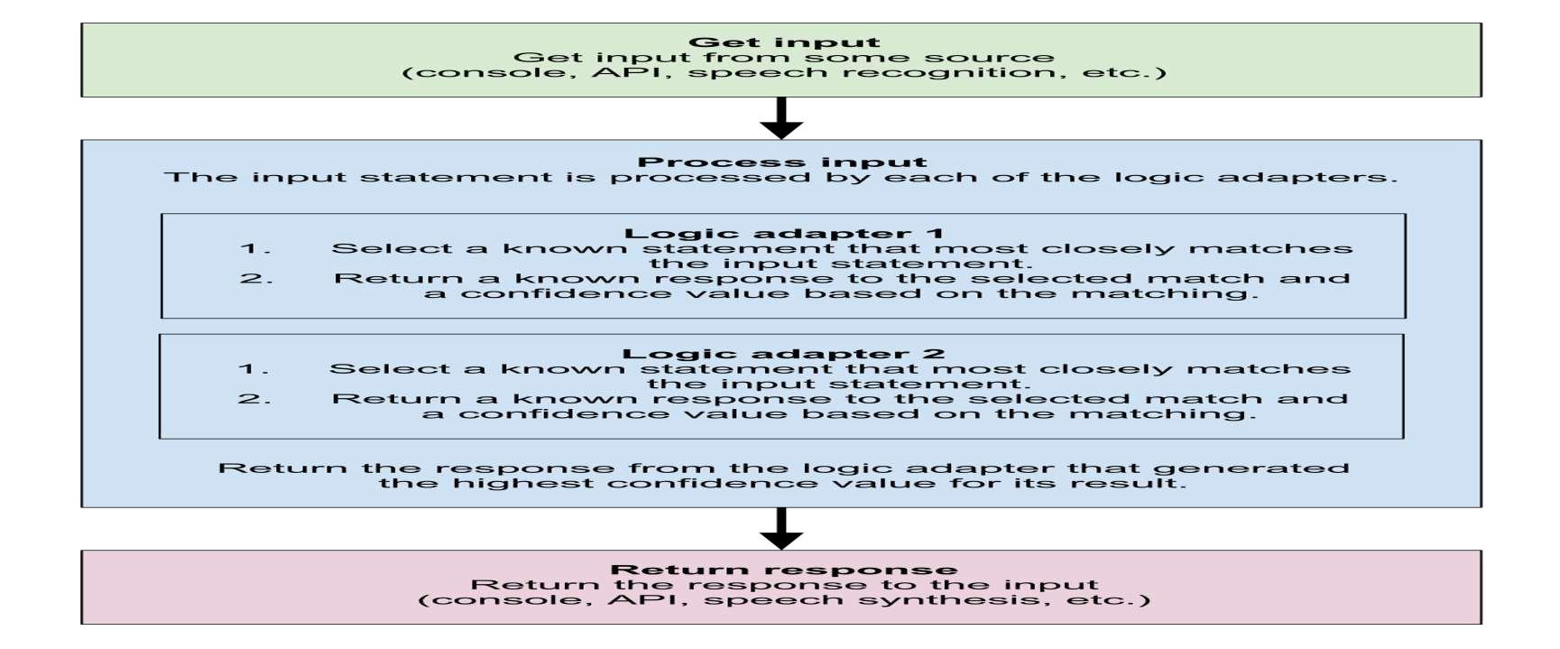

Slide 23
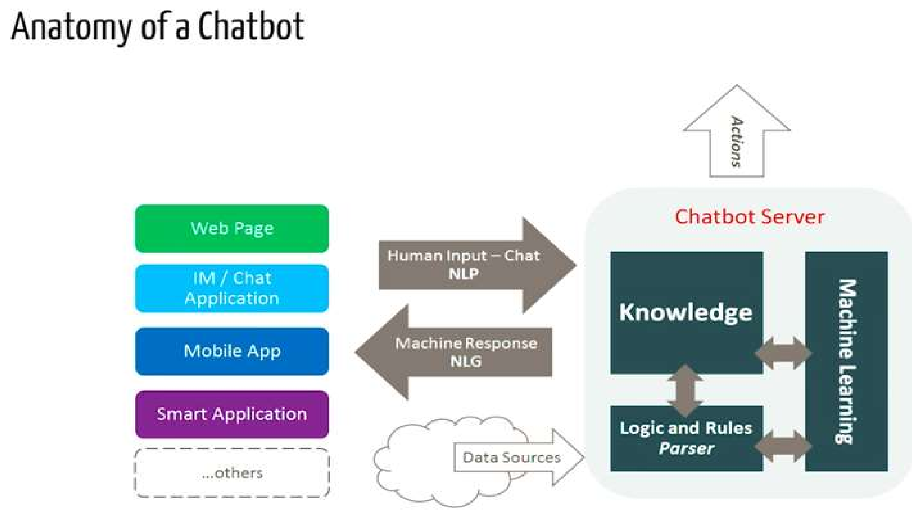

Slide 24
ARCHITECTURE OF HEALTHCARE CHATBOT

Slide 25
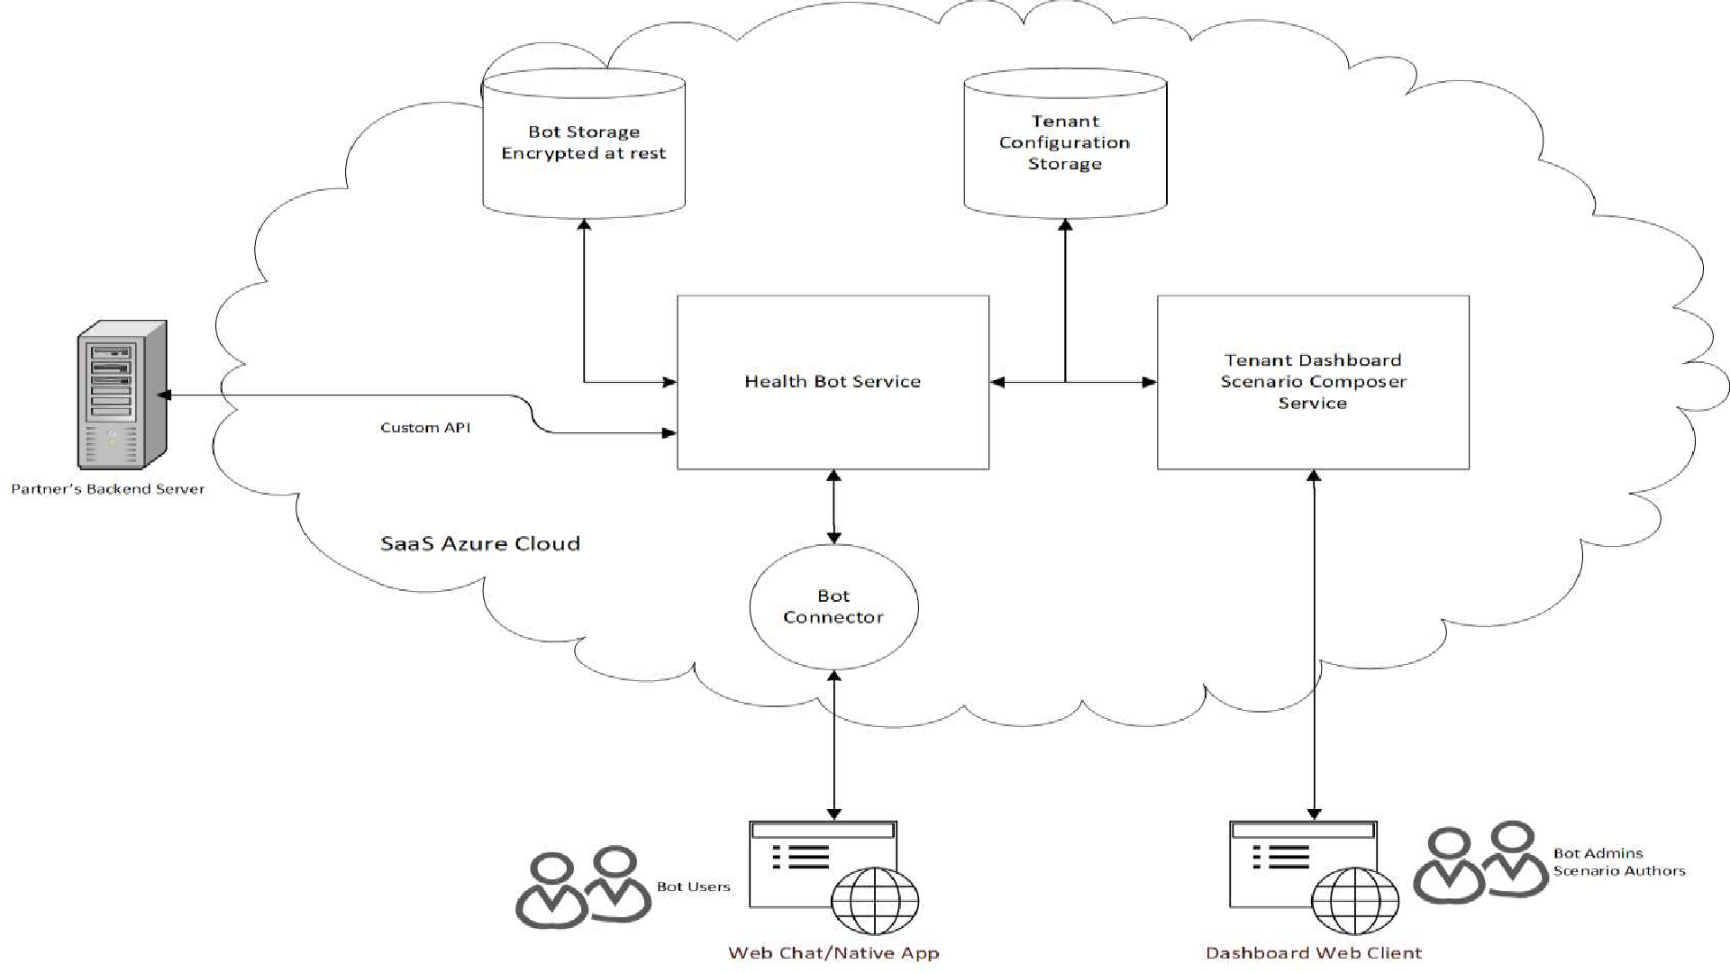

Slide 26
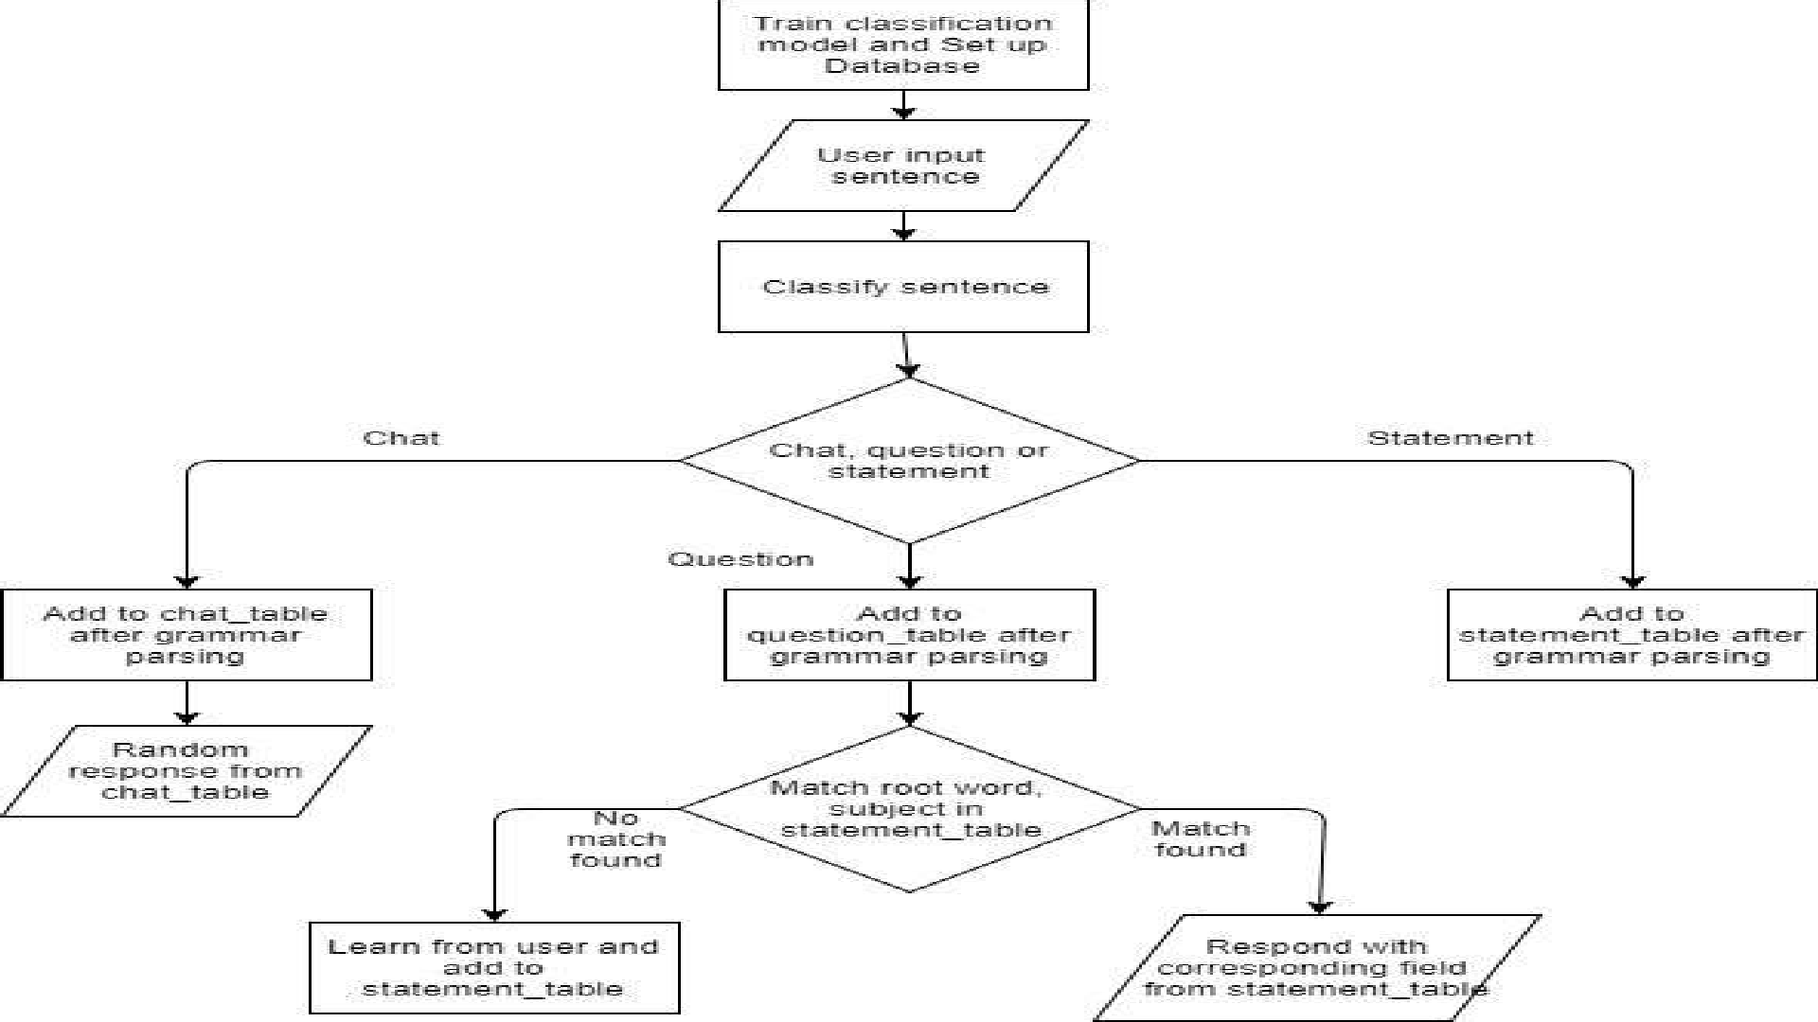

Slide 27
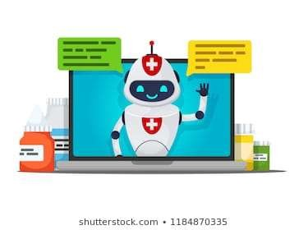
CHALLENGES AND LIMITATION
Giving human
intelligence is almost
impossible
Time constraints
Enough knowledge representation
Should be very specific keyword
Technological limitation of AI
Medical limitation
Ethical challenges
Better regulations
Misconceptions and overhyping
Human rejection

Slide 28


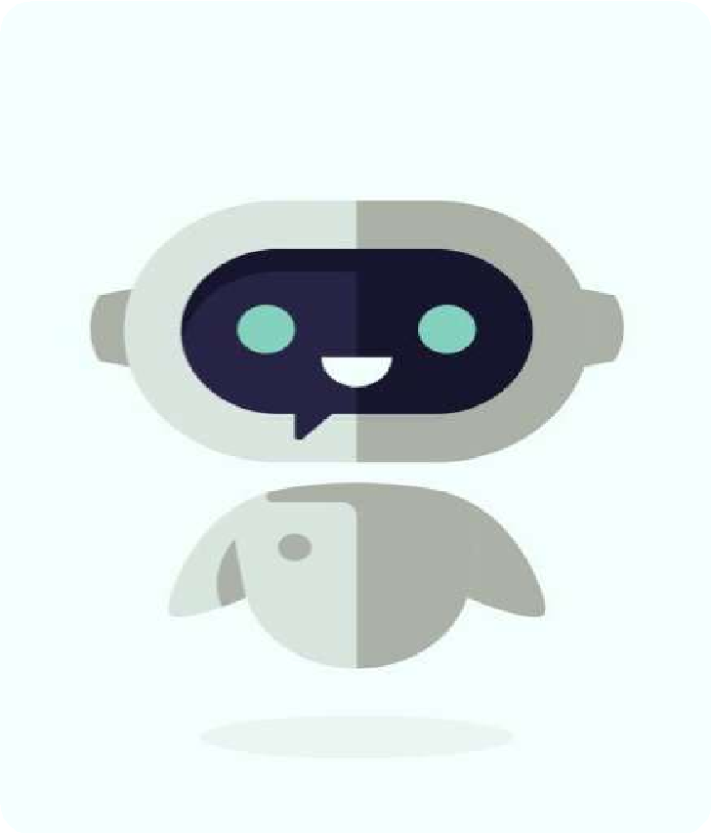
FUTURE SCOPE OF AI IN HEALTHCARE
More efficent and Voice Chatting chatbot .
Chatbots are everywhere, and the sector where they will probably make the maximum impact on in the near future is healthcare.
No need to pay unnecessary visits to a doctor, chatbots are here to help you AI and ml-powered solutions have already shown the ability to perform tasks, in many cases, Better than humans. Leaders like amazon are calling AI a “golden age” and are setting a new Standard for competitive differentiation.
AI is expected to enhance healthcare for both patients and doctors . Clubbed with big data analytics, AI could yield faster and accurate diagnoses . All these would result in decreased healthcare cost .

Slide 29
DATA SAFETY AND PRIVACY AND RISK
The ministry of health and family welfare is working on a sector - specific legislation , tentatively called the healthcare data privacy and security act .
In 2016 , the hacking of a Mumbai – based diagnostic laboratory database led to the leaking of medical records ( including HIV reports of over 35000 patients ) .
Hacker can exploit AI solutions to collect private and sensitive information such as electronic health record .

Slide 30
SECURITY FOR CHATBOTS
The privacy and security of patient health information is a top priority for patients and their families, health care providers and professionals, and the government. Federal laws require many of the key persons and organizations that handle health information to have policies and security safeguards in place to protect your health information — whether it is stored on paper or electronically.
HIPAA, also known as Public Law 104-191 . The act, which was signed into law by President Bill Clinton on Aug. 21, 1996 .
The Health Insurance Portability and Accountability Act of 1996 (HIPAA) is the main Federal law that protects health information. The HIPAA Privacy and Security Rules protect the privacy and security of individually identifiable health information. HIPAA Rules have detailed requirements regarding both privacy and security.
The HIPAA Privacy Rule covers protected health information (PHI) in any medium .
The HIPAA Security Rule covers electronic protected health information (ePHI).

Slide 31
CONCLUSION
THE KEY IS TO ENSURE THAT MAJORITY OF THE POPULATION CAN ACCESS AND THEREFORE BENEFIT FROM THIS TECHNOLOGICAL DISRUPTION. IF INDIA IS SUCCESSFUL IN DOING SO, THERE IS AN OPPORTUNITY TO BENEFIT FROM THE POSITIVE CHANGES THAT TECHNOLOGY WILL BRING TO HEALTHCARE.
ARTIFICIAL INTELLIGENCE HAS A RANGE OF APPLICATIONS ACROSS THE HEALTHCARE SECTOR. BY PERFORMING DESCRIPTIVE, PREDICTIVE AND PRESCRIPTIVE FUNCTIONS, AI IN HEALTHCARE IN INDIA IS CURRENTLY AUGMENTING HUMAN CAPACITY RATHER THAN TO REPLACING HUMAN LABOUR ALTOGETHER.

Slide 32
HealthCare Chatbot Software Information
This chatbot is created by python and feature used for making this chatbot are following:-
1. SQL Database :- It stored the data of user such as name, email, phone number etc.
2. Pytq5 Framework :- This frame work is used design the software body. It support operating system such as window, mac etc.
3. Scikit-Learn Framework :- This Framework is used for adding the machine learning algorithm in the software. In this we use Random Forest Algorithm.
4. Data Sets:- We used the data set to train the software model . In this software we use Doctor data-set, Precaution data-set etc.

Slide 33
5. Google Maps:- It is used show the nearest hospitals locations from your current location.
Operation System requried:- Windows ,Mac , Linux etc.
Features:-
1. Easy to use
2. Help to find the diesase and its precations.
3. Show the nearest hospital.
4. 24x7 service.
5. User Friendly

Slide 34
THANK YOU

